Slide 1
Compiler design mini- project presentation
Submitted to – Mrs minu p. Abraham
Dept. of cse, nmamit, nitte
Project by –
Gagandeep bekal (4nm17cs062)
Harshit sunil shirsat (4nm17cs068)

Slide 2
Code snippet given
int main()
begin
int L[10];
int maxval=L[0];
for i=1 to n-1 do
if L[i]>maxval
maxval=L[i];
endif
endfor
return(maxval)
End

Slide 3
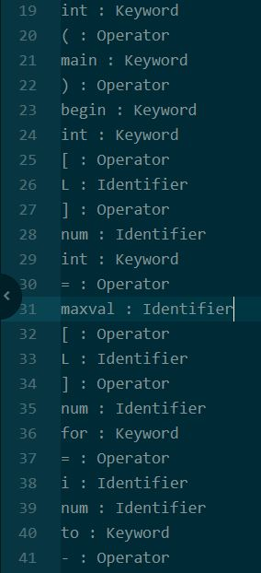
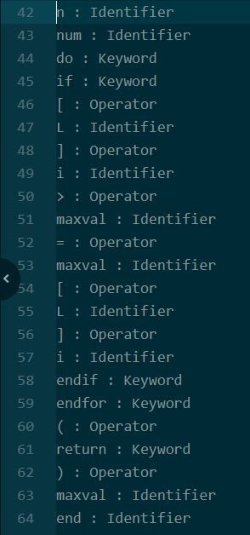
Output of lexical analyzer

Slide 4
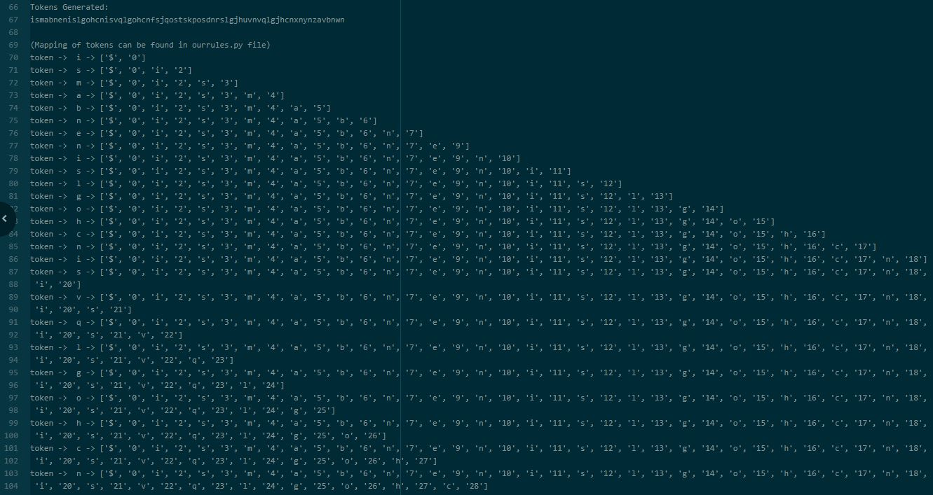
Output of Syntax analyzer

Slide 5
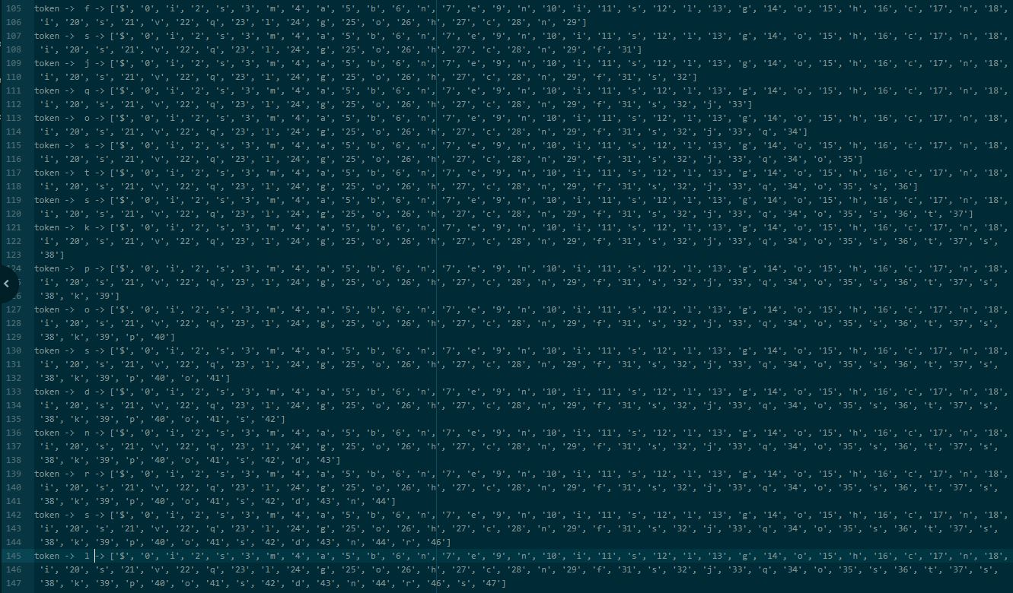
Output of Syntax analyzer

Slide 6
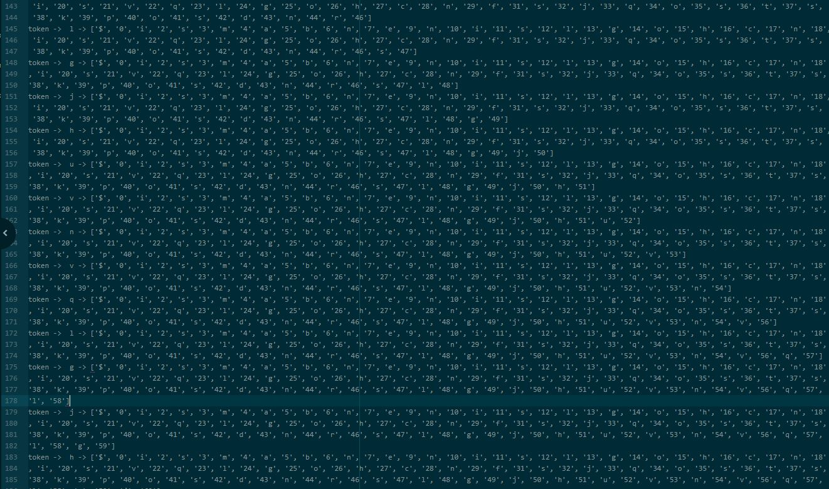
Output of Syntax analyzer

Slide 7
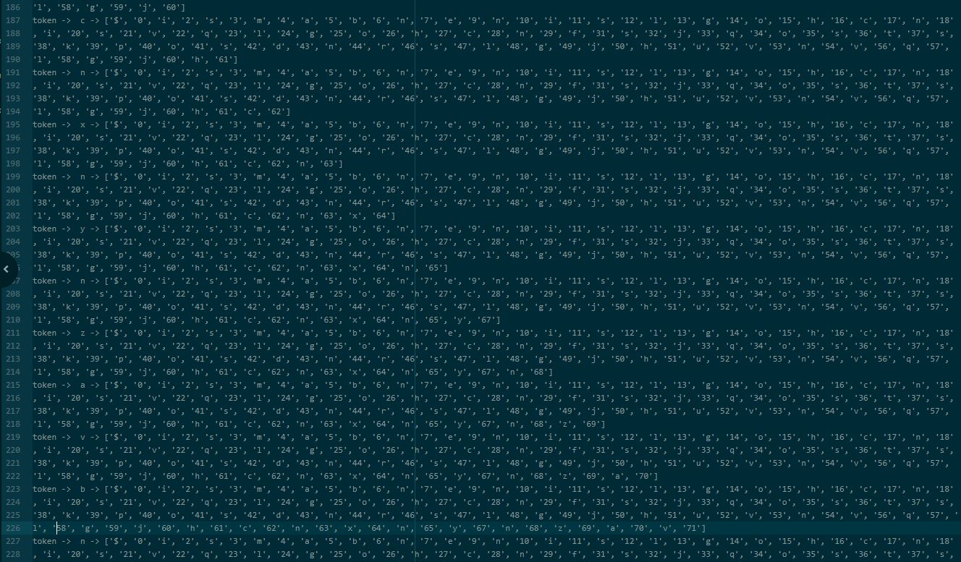
Output of Syntax analyzer

Slide 8
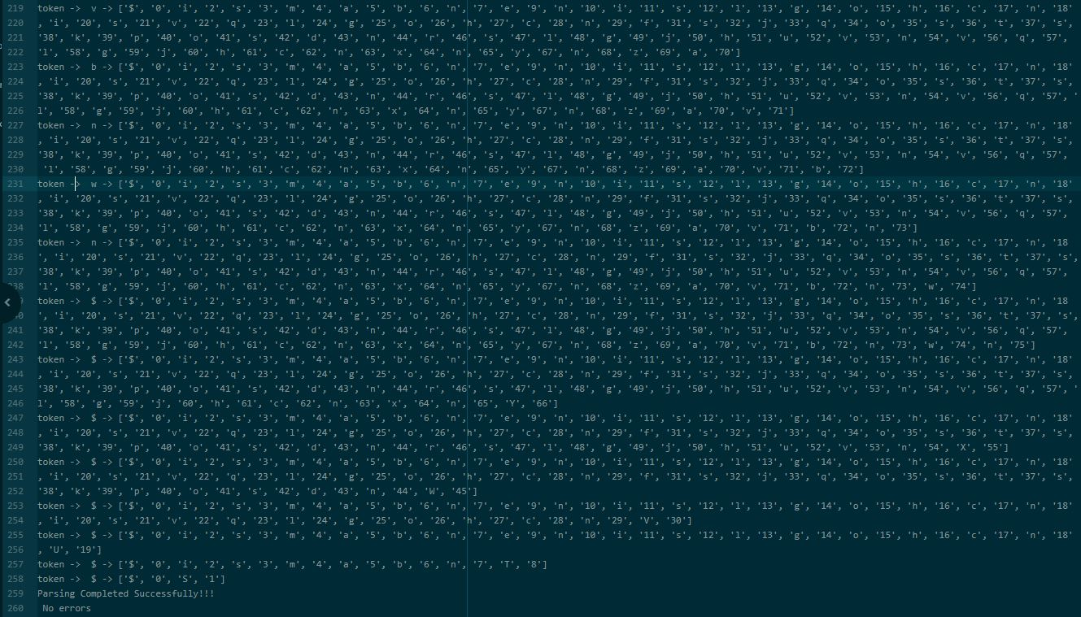
Output of Syntax analyzer

Slide 9
Thank You

